Slide 1
SW Competency Preparation Tips

Slide 2
Why?
SW Competency is needed in order for SRI-B to be called an advanced R&D center
Chance to demonstrate your Computer Science skills (and earn some incentives)
Useful outside the company also :-)

Slide 3
When?
2015 Dates
Advanced Level Tests – July onwards
Professional Level Tests – Aug and Oct
Prof High Level Test – Nov
Expert Level Test in HQ – Dec
Pattern:
3 hours, 1 question
Languages: C++/Java/C

Slide 4
HOW?
Start with basics and get thorough in them
Avoid theory… get your hands dirty
Just knowing the algorithm is not enough.. Understand the nuances and complexity(both space and time)
Be aware of edge cases and error conditions

Slide 5
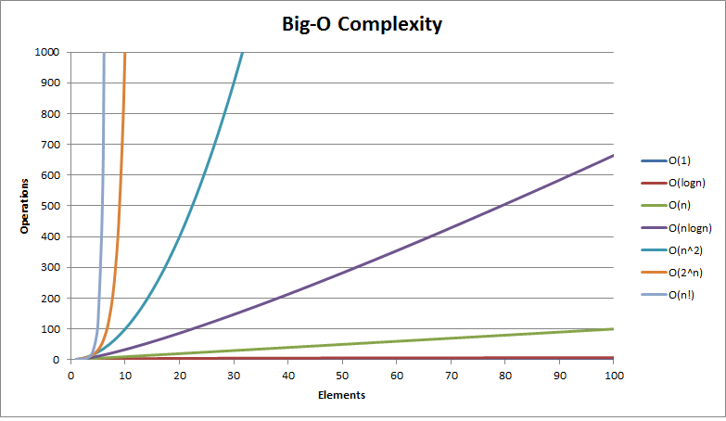
N | logN | N | N logN | N ² | N ³
10⁶ | 0.020 μs | 1 ms | 19.93 ms | 16.7 min | 31.7 days
10⁹ | 0.030 μs | 1 s | 29.90 s | 31.7 years

Slide 6
Basic Topics
Arrays – 1D, 2D | Binary heap
Binary search | BST
Stack | Hash Table
Queue | Bit Manipulation
List | Basic Maths, Geometry
Tree | Recursion
Sorting – at least 3 types

Slide 7
Advanced Topics
String Processing – Radix Sort, KMP/Boyer-Moore, Tries
Graph Traversal – DFS, BFS
Topological Sort
Minimum Spanning Tree – Kruskal and Prim
Shortest Path - Dijkstra and Bellman-Ford
Max Flow, Min Cut – Ford-Fulkerson
Bipartite Matching
Dynamic Programming

Slide 8
Graphs
Terminology:
Vertex, Edge
Path
Cycle
Degree – indegree and outdegree
Sparse and Dense Graphs
Directed and Undirected Graphs
Graph Representation:
Adjacency Matrix
Adjacency List

Slide 9
External References
GeeksForGeeks - http://www.geeksforgeeks.org/
HackerRank - https://www.hackerrank.com/
TopCoder - https://www.topcoder.com/ Has excellent tutorials on each topic
Coursera, Udacity - https://www.coursera.org https://www.udacity.com/
Introduction to Algorithms – Cormen, Leiserson, Rivest, Stein

Slide 10
Level 4 and 5 problems from previous HQ tests

